Slide 1
24
7
30
Date
Logarithms and their Laws
EQ – What are the laws of common logarithms?
Before we get into the laws of common logarithms, let’s see some examples of logarithms in the real world and solidify what we learned last class...
Notes:
Input

Slide 2
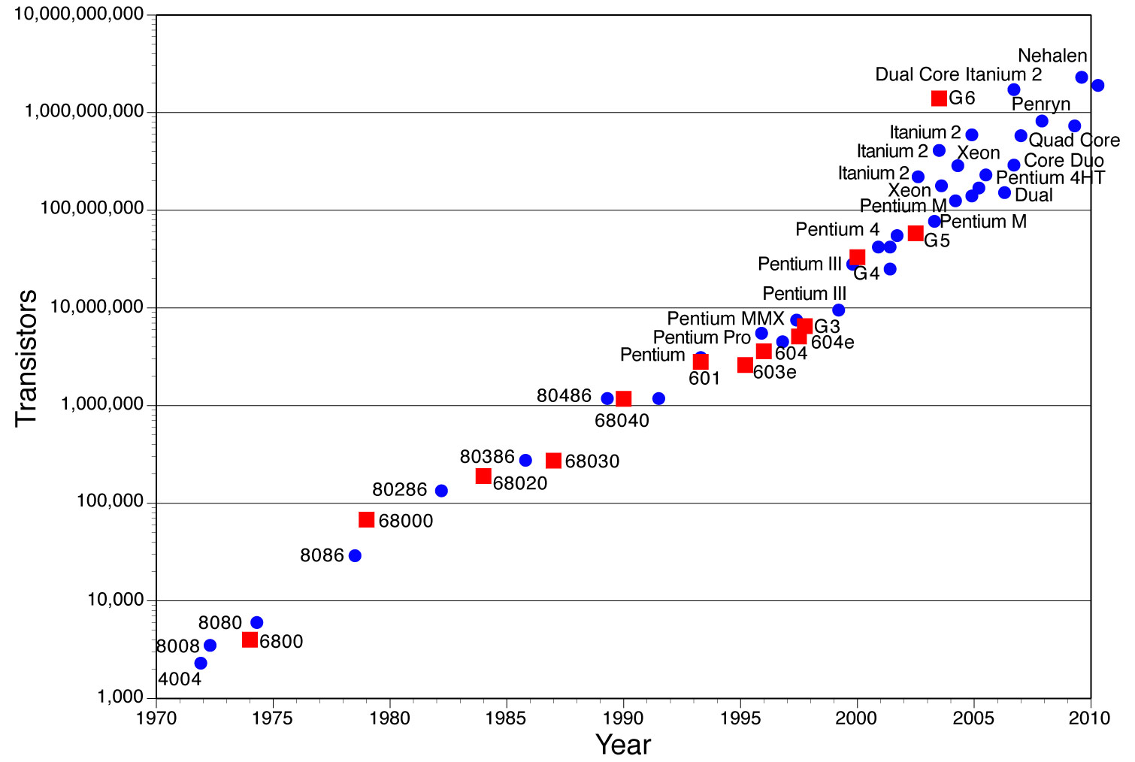
Using logs in science
The well-known “Moore’s Law” states that the processing power of computers doubles every two years. It’s been remarkably accurate so far!
If we were to plot the number of transistors against the year, the type of graph would be exponential.
The graph would look rubbish if we chose a range of values on the y-axis to accommodate all the values, because except for the last few years, most of the points would look close to 0.
?

Slide 3
Using logs in science
The well-known “Moore’s Law” states that the processing power of computers doubles every two years. It’s been remarkably accurate so far!
This graph gets around the problem by letting the y-values increase by a factor of 10 for each unit, rather than increasing by a constant amount each time. Technically this is not allowed!

Slide 4
Using logs in science
The well-known “Moore’s Law” states that the processing power of computers doubles every two years. It’s been remarkably accurate so far!
10
We could instead use a logarithmic scale. We can take the log base 10 of these values. Then we’ll get 3, 4, 5, 6, ..., which is now allowed!*
9
8
7
log₁₀(Number of transistors)
6
5
Logarithmic scales turn exponential graphs into linear ones (i.e. a straight line), thus making it much easier to plot all the points together.
4
3
* Although realistically, a scale of 10, 100, 1000, etc. is permissible as long as we’re mindful that it’s a logarithmic scale.

Slide 5
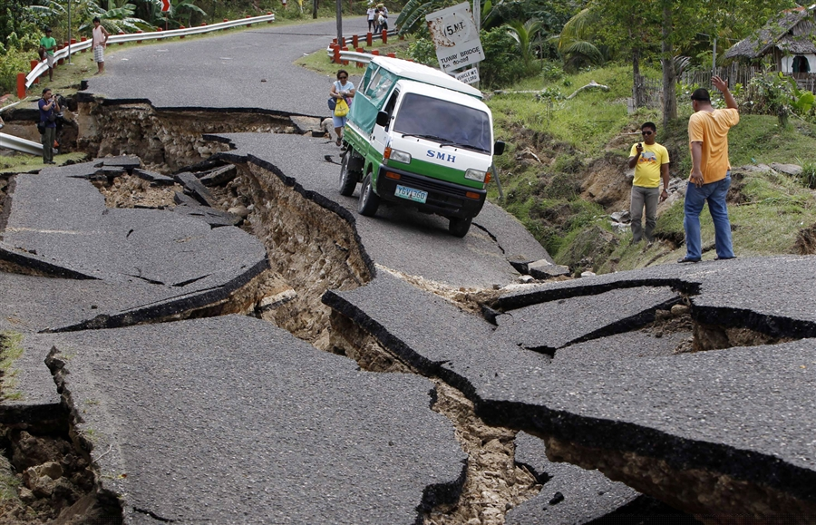
Using logs in science
Logarithmic scales are used for earthquakes and noise levels.
log_{a} ax = 1 + log_{a} x
From our laws of logs, in base a...
when a quantity gets a times bigger,
the overall result only increases by 1.
Thus using logarithms turns a factor difference into a constant difference.
The Richter Scale is used to measure the magnitude of earthquakes. The scale is logarithmic (base 10): it means if amplitude of the earthquake’s waves gets 10 times bigger, the value on the Richter Scale only increases by 1.
Earthquakes of magnitude 6 vs 7 doesn’t look like a substantial difference, but just the one point difference means it’s ten times worse!

Slide 6
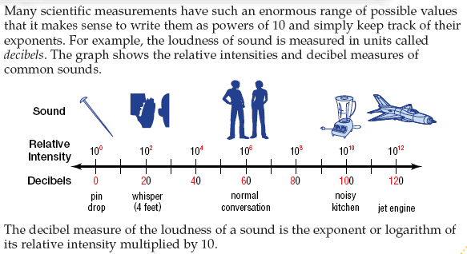
Why is logarithmic scale used to measure sound?

Slide 7
24
7
30
Date
Logarithms and their Laws
EQ – What are the laws of common logarithms?
From last class:
Function
Inverse
81
4
3^{x}
log₃ x
4
?
How therefore would describe the effect of log₃ x in words?
log₃ x
It finds the power that, when 3 is raised to it, gives you x.
i.e. If y = log₃ x, then 3^{y} = x
It is the opposite/inverse of indices.
We describe this as the “logarithm of x base 3” or “log of x base 3” or “taking the log of x base 3”.
Notes:
Input

Slide 8

24
7
30
Date
Logarithms and their Laws
EQ – What are the laws of common logarithms?
There are 4 main laws you need to know well. We will start with basic examples then work towards questions that combine multiple laws. The laws are:
1. log_{b} xy = log_{b} x + log_{b} y
2. log_{b} $\frac{x}{y}$ = log_{b} x - log_{b} y
3. log_{b} 1 = 0
4. log_{b} b = 1
Notes:
Input

Slide 9




Slide 10
Laws of Logs
Write the following as a single logarithm, do not evaluate yet.
Rule
1.
2.
3.
4.
log₂ 12 + log₂ 4
log₃ 48
?
log₂ 5
log₂30 – log₂6
?
?
log₄ 1
0
log₇ 7
1
?

Slide 11
12.9 – Laws of Logarithms
Worksheet

Slide 12
Logarithms Kahoot!
https://play.kahoot.it/#/k/a16d69d6-dfef-4b2e-9795-29a85f723e3c

